Slide 1
SNIP – Single Shot Network Pruning Based on Connection Sensitivity
Namhoon Lee, Thalaiyasingam Ajanthan & Philip H. S. Torr
University of Oxford

Slide 2
Summary
Proposes a new method for pruning deep neural networks that can reduce the number of parameters and computational cost without sacrificing performance.
Based on a saliency criterion that measures the importance of each connection in the network before training.
Method is simple, versatile, and interpretable, and can be applied to various architectures such as convolutional, residual, and recurrent networks

Slide 3
Motivation
Why Pruning ?
Pruning large neural networks can improve their efficiency, generalization, and interpretability
Enable deployment on resource-limited devices and applications

Slide 4
Motivation
Challenges of existing methods:
Most existing methods require pretraining, complex pruning schedules, additional hyperparameters, or architecture-dependent constraints
Depend on the scale of the weights or the Hessian matrix, which are not reliable indicators of connection importance

Slide 5
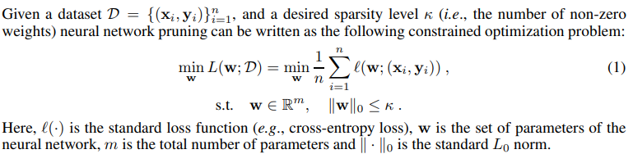
Related Work
Conventional Approach:
Optimize by adding sparsity enforcing penalty terms
Drawbacks:
Methods often turn out to be inferior to saliency-based methods in terms of resulting sparsity and require heavily tuned hyperparameter settings to obtain comparable results.

Slide 6
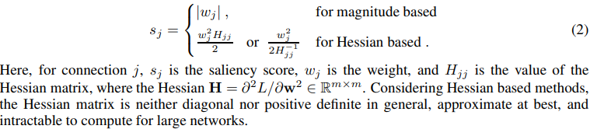
Related Work
Saliency based methods treat the problem as selectively removing redundant parameters (or connections) in the neural network
Criterion:
Magnitude of weights i.e. weights below threshold value are redundant
Hessian of the loss with respect to the weights

Slide 7
Related Work
Drawbacks:
Both of these criteria depend on the scale of the weights and in turn require pretraining and are very sensitive to the architectural choices
For instance, different normalization layers affect the scale of the weights in a different way, and this would non-trivially affect the saliency score
Pruning and the optimization steps are alternated many times throughout training, resulting in highly expensive prune – retrain cycles

Slide 8
Method
Connection Sensitivity
It is the normalized magnitude of the derivatives of the loss function with respect to the binary indicators of connection presence
Goal - Design a method that can selectively prune redundant connections for the given task in a data-dependent way even before training

Slide 9
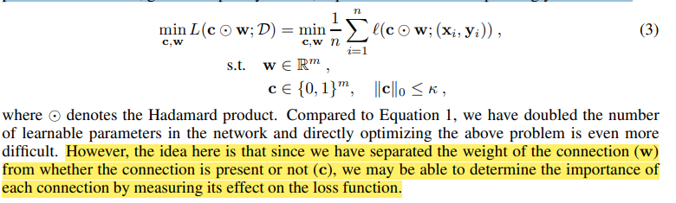
Method
Intend to measure the importance (or sensitivity) of each connection independently of its weight
Introduce auxiliary indicator variables c ∈ {0, 1}^{M} representing the connectivity of parameters w. Now, given the sparsity level κ, Equation 1 can be correspondingly modified as

Slide 10
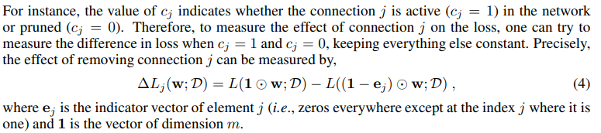

Method
Note that computing ∆Lj for each j ∈ {1 . . . m} is prohibitively expensive as it requires m + 1 (usually in the order of millions) forward passes over the dataset. In fact, since c is binary, L is not differentiable with respect to c, and it is easy to see that ∆Lj attempts to measure the influence of connection j on the loss function in this discrete setting. Therefore, by relaxing the binary constraint on the indicator variables c, ∆Lj can be approximated by the derivative of L with respect to cj , which we denote gj (w; D). Hence, the effect of connection j on the loss can be written as:

Slide 11
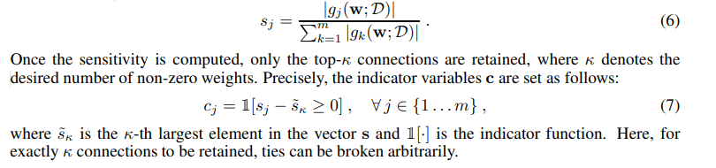
Method

Slide 12
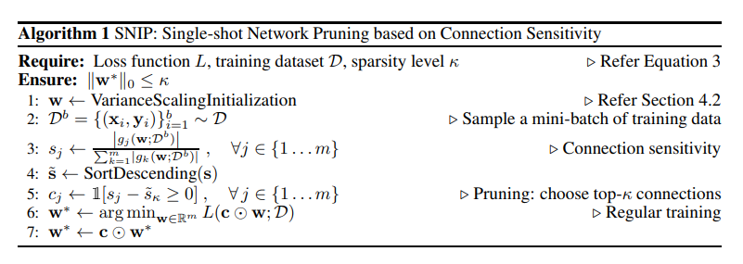
Method

Slide 13
Discussion
Saliency measure defined in Equation 6 depends on the value of weights w used to evaluate the derivative as well as the dataset D and the loss function L
Firstly, in order to minimize the impact of weights on the derivatives ∂L/∂cj, we need to choose these weights carefully. For instance, if the weights are too large, the activations after the non-linear function (e.g., sigmoid) will be saturated, which would result in uninformative gradients
Additionally, saliency measure should be robust to architecture variations
If the initial weights have a fixed variance, this would make the gradient and in turn our saliency measure, to be dependent on the architectural characteristics therefor initialize with variance scaling

Slide 14
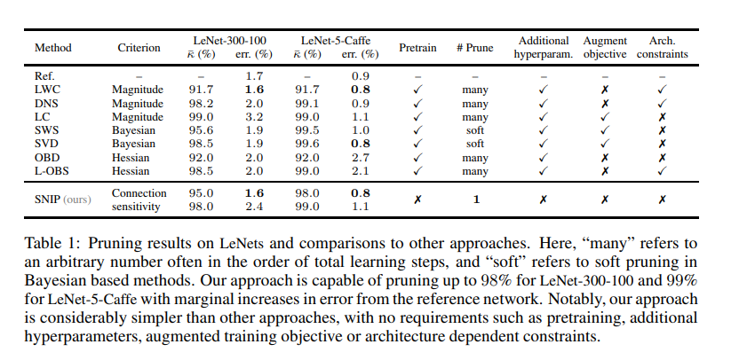
Comparisons with previous work

Slide 15
Experiment
Dataset – MNIST, CIFAR10
Architectures- AlexNet, VGG, WRN, LSTM, GRU

Slide 16
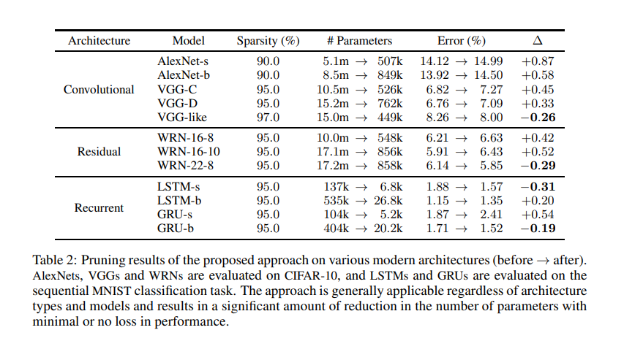
Results from Papers

Slide 17
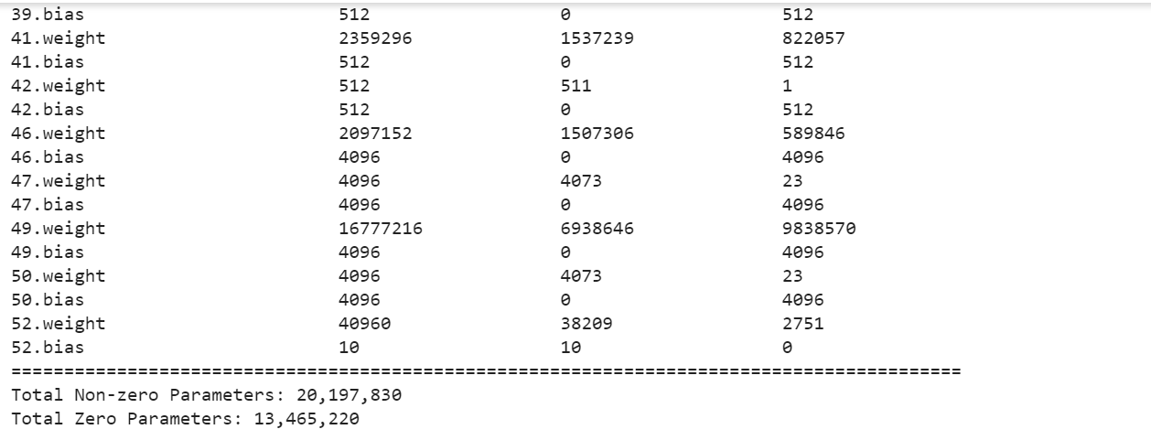
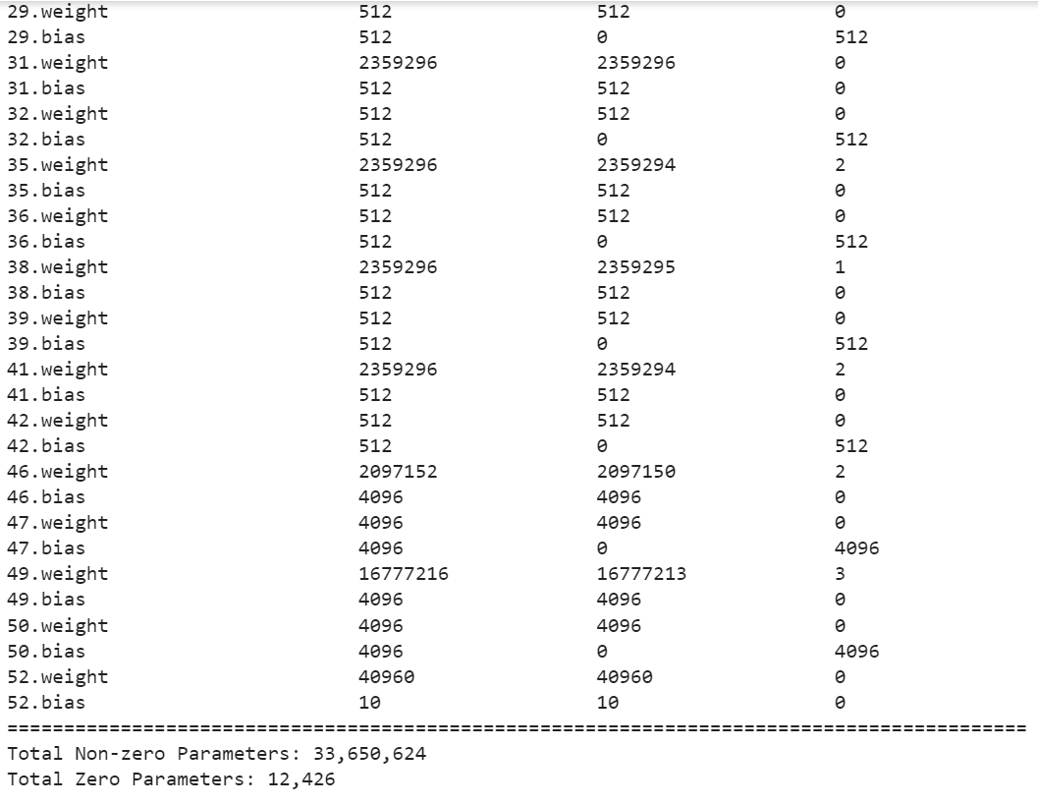
Experimental Results
Before Pruning After Pruning

Slide 18
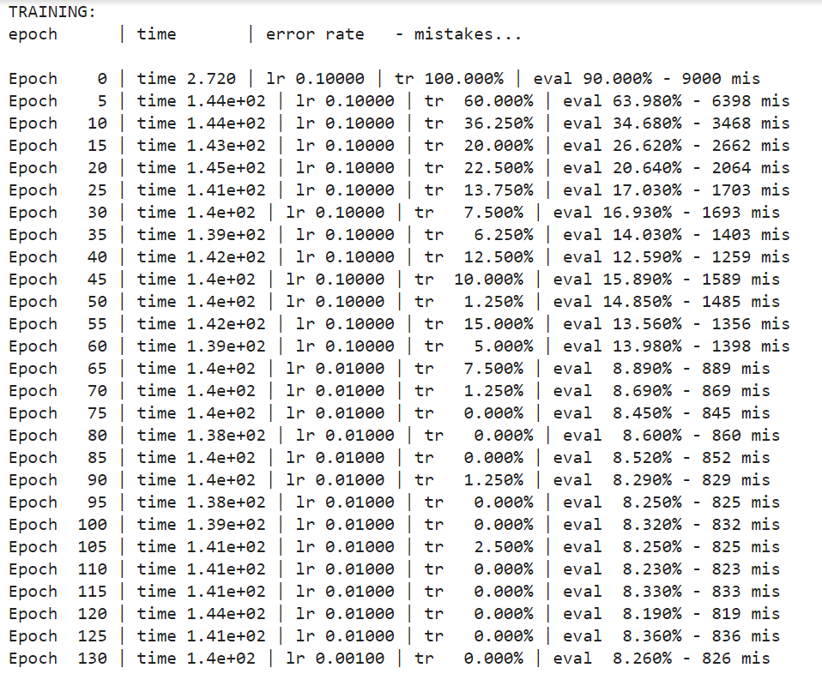
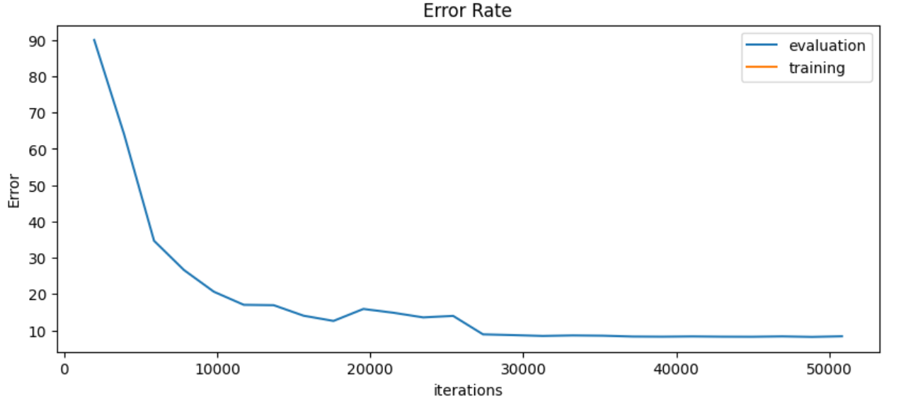
Experimental Results

